Slide 1
Deep Learning
Multi-Layered Feed Forward Neural Network

Slide 2
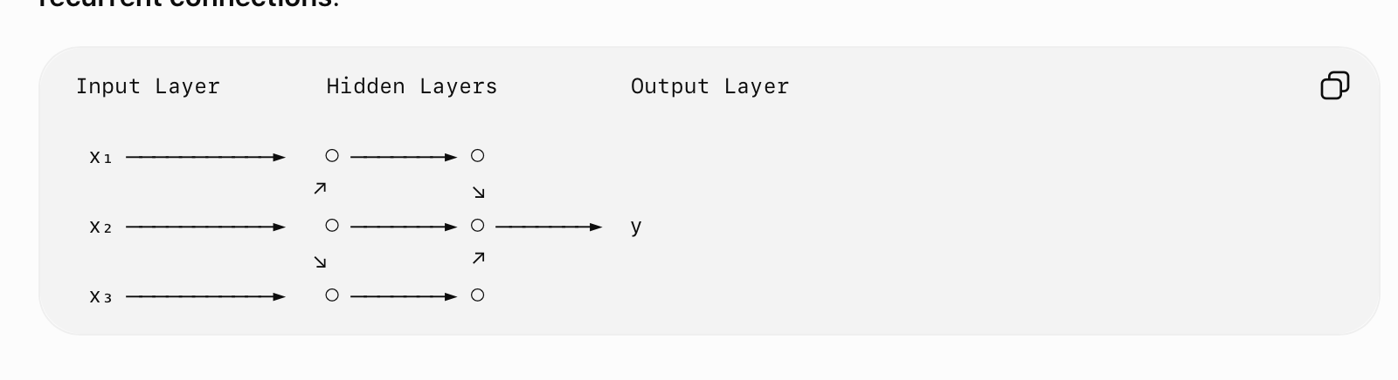
Multi-Layered Feed Forward Neural Network
A Multi-Layered Feed Forward Neural Network (MLFFNN) is an artificial neural network consisting of an input layer, one or more hidden layers, and an output layer.
The information flows only in the forward direction, from input to output. There are no feedback or recurrent connections.

Slide 3
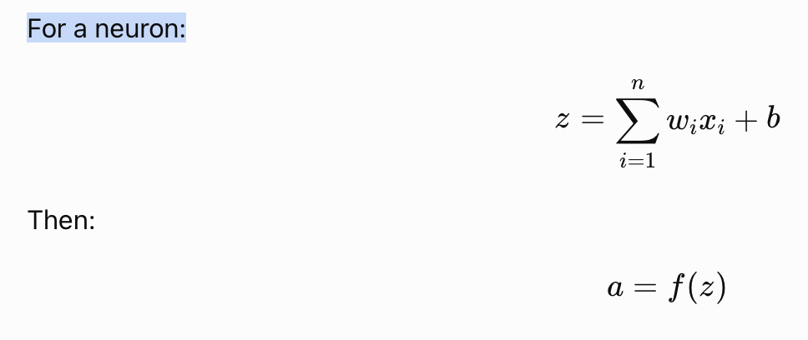
Basic Architecture
A typical MLFFNN contains three types of layers:
1. Input Layer
  Receives the input features.
  Does not normally perform a major computation.
  Each neuron corresponds to an input feature.
Example :
  X = [x1,x2,x3]
2. Hidden Layer
  Performs mathematical transformations on the input.
  A network can have one or multiple hidden layers.
  Each neuron generally performs a weighted sum followed by an activation function.

Slide 4
Basic Architecture
Output Layer
  Produces the final prediction.
  The number and type of output neurons depend on the problem.
Examples:
  Binary classification → commonly one output
  Multiclass classification → multiple outputs, often with Softmax
  Regression → commonly one continuous output

Slide 5
Why is it called "Feed Forward"?
It is called feed forward because information moves in only one direction:
Input Layer ------- Hiddne Layer ------- Output Layer
There is no connection from a later layer back to an earlier layer during the forward pass.
Let’s Explore Mathematical Representation.

Slide 6
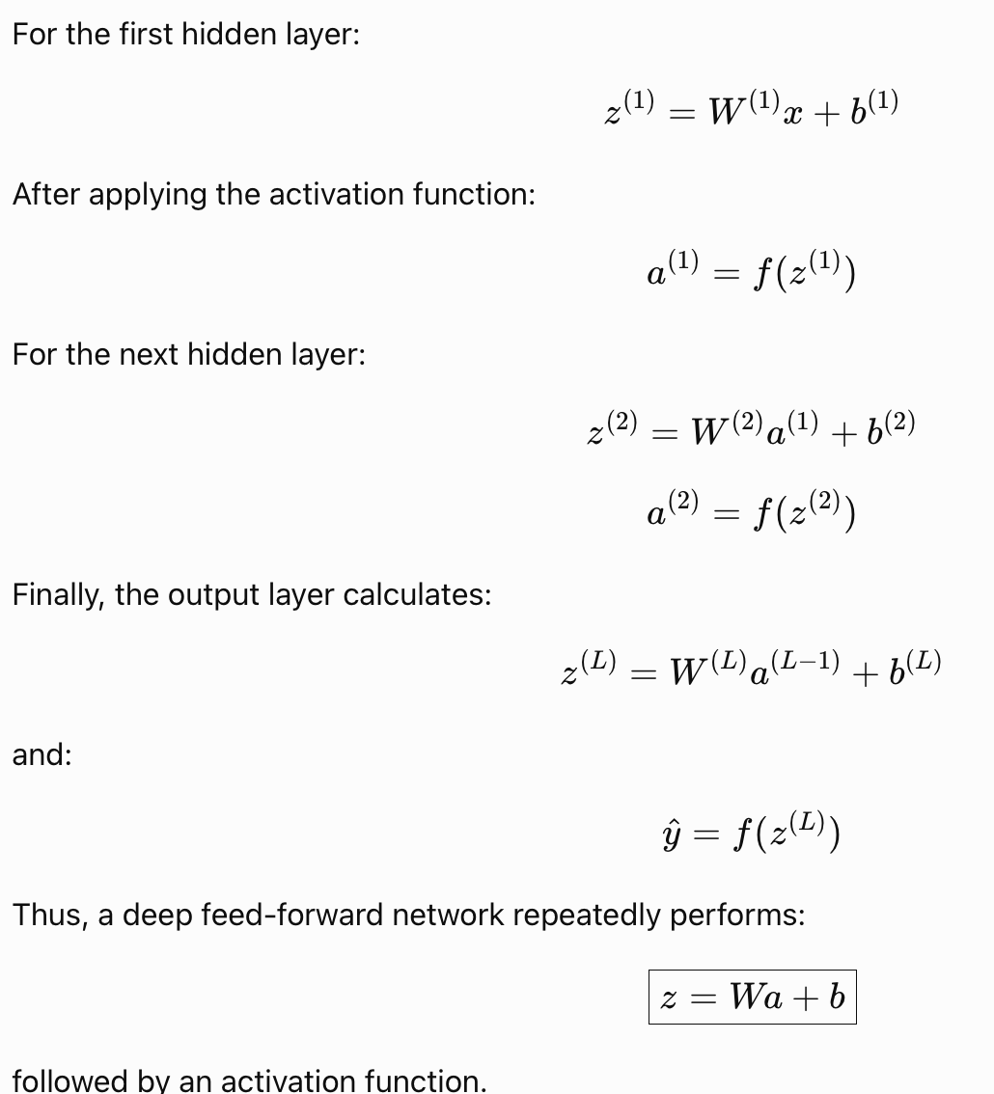
Mathematical Representations

Slide 7
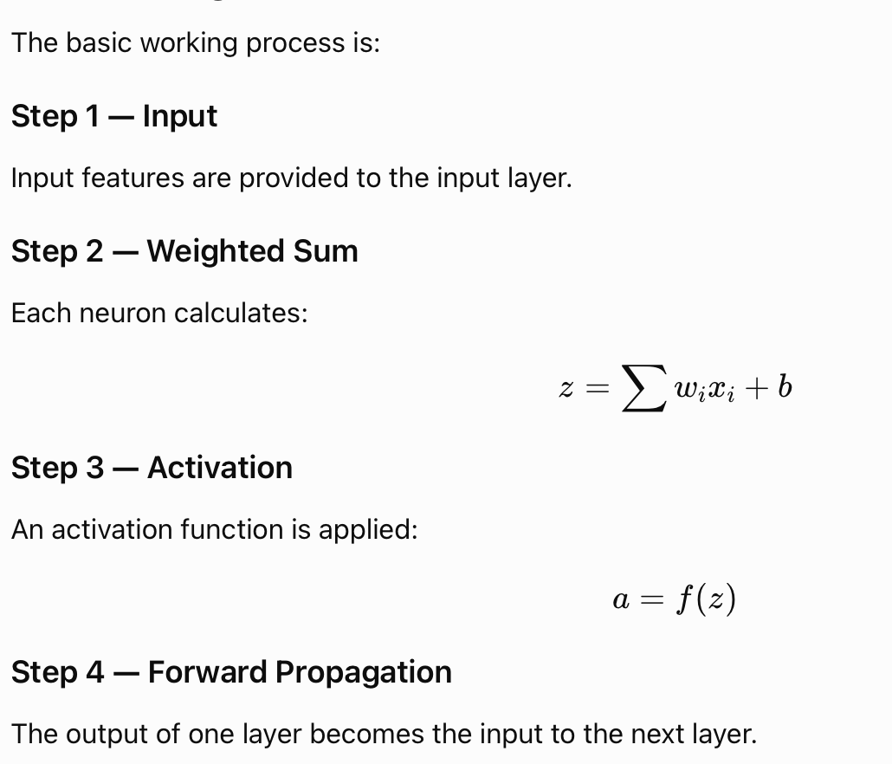
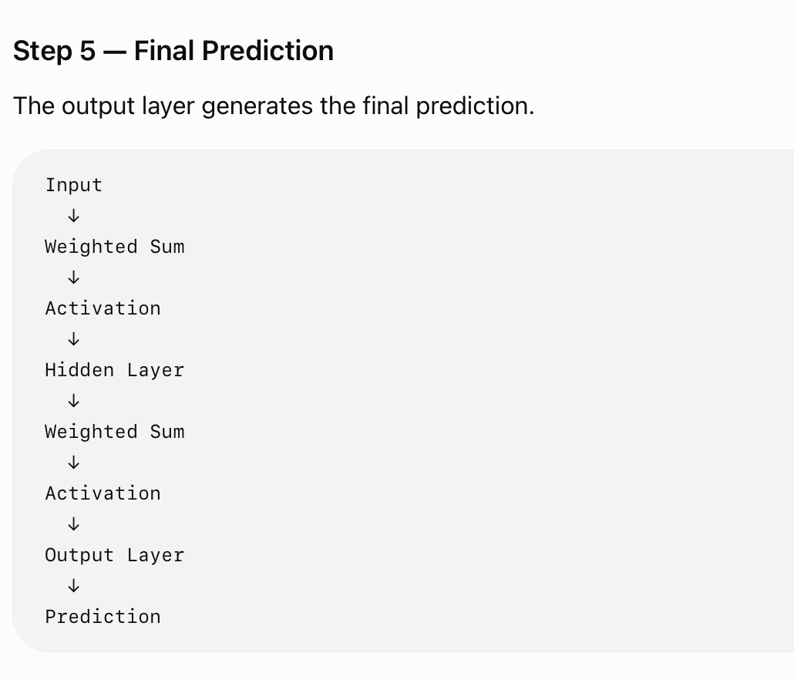
Working of MLFFNN

Slide 8
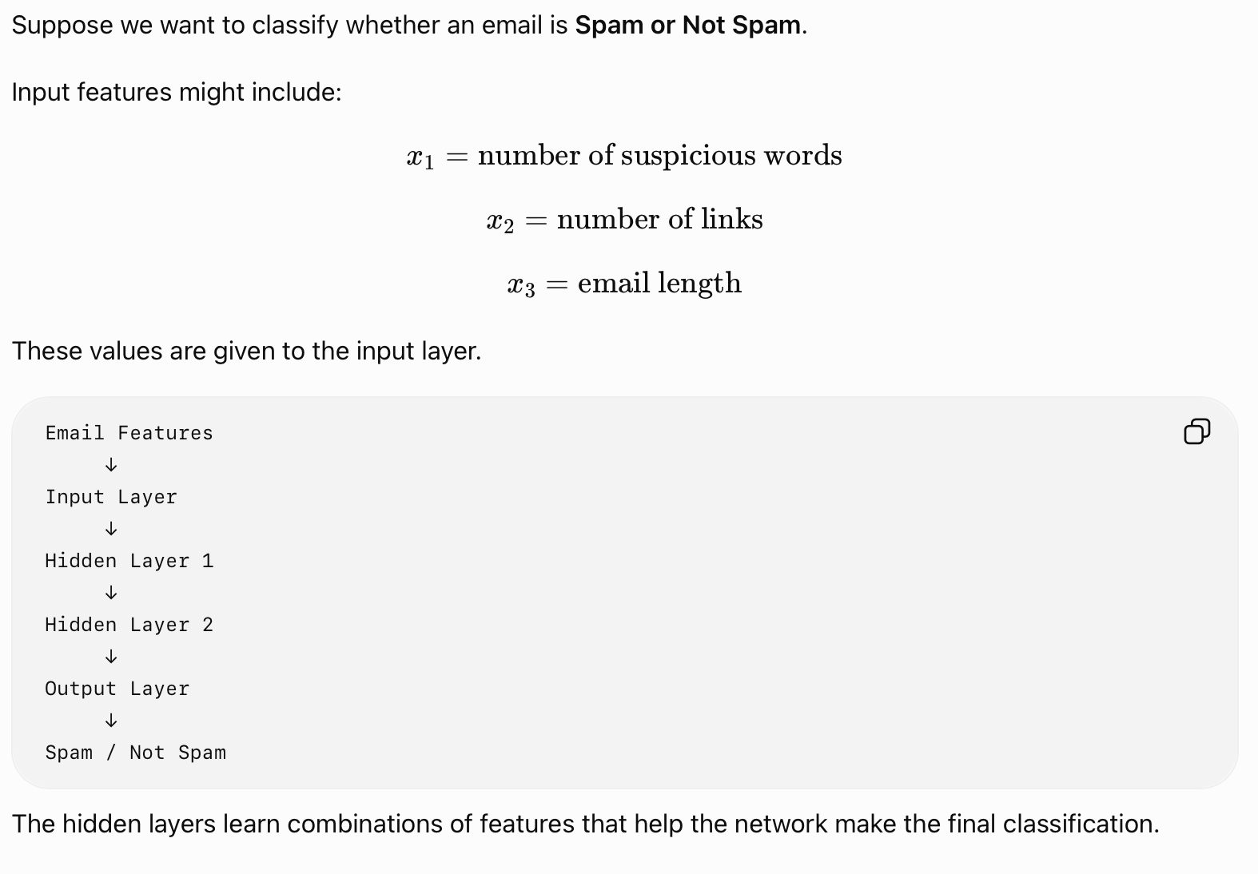
Example
Requires appropriate training data.
Training can be computationally expensive for large networks.
Can suffer from overfitting.
Choice of architecture and hyperparameters affects performance.
Deep networks can be difficult to interpret.

Slide 9
Comparision Table
Feature | Feed Forward NN | Recurrent NN
Information flow | Forward only | Can include recurrent connections
Memory | No internal sequence memory | Maintains information through recurrent state
Main use | Classification, regression, pattern recognition | Sequential/time-series data
Feedback connection | No | Yes
Example | MLP | RNN, LSTM

Slide 10
Activation Function
2.2

Slide 11
Introduction
An activation function determines the output of a neuron based on its weighted input and introduces non-linearity into a neural network.
For a neuron:
  z=Wx+b
The activation function produces:
  a=f(z)
Without nonlinear activation functions, stacking multiple neural-network layers would effectively behave like a linear transformation, limiting the network's ability to learn complex relationships.

Slide 12
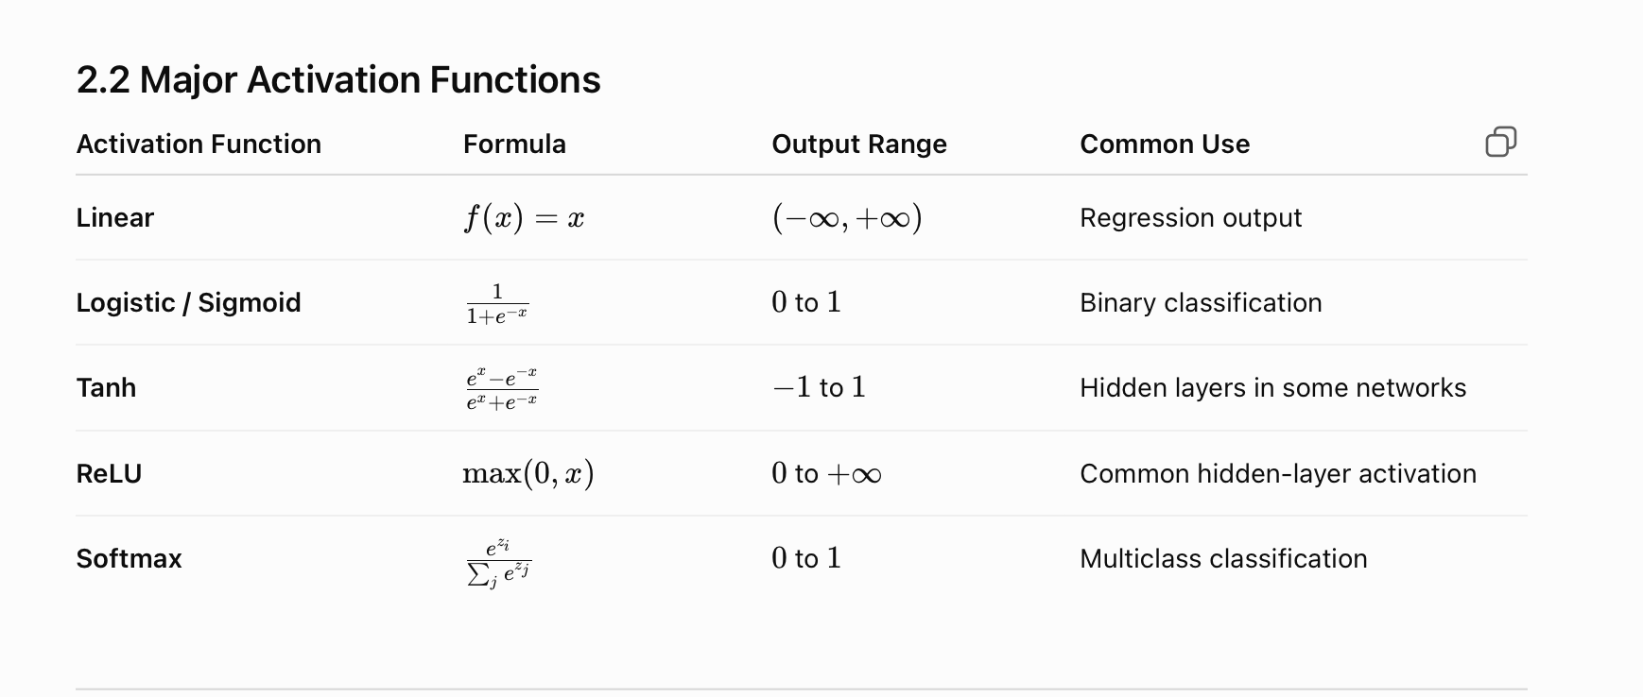
Major Activation Function

Slide 13
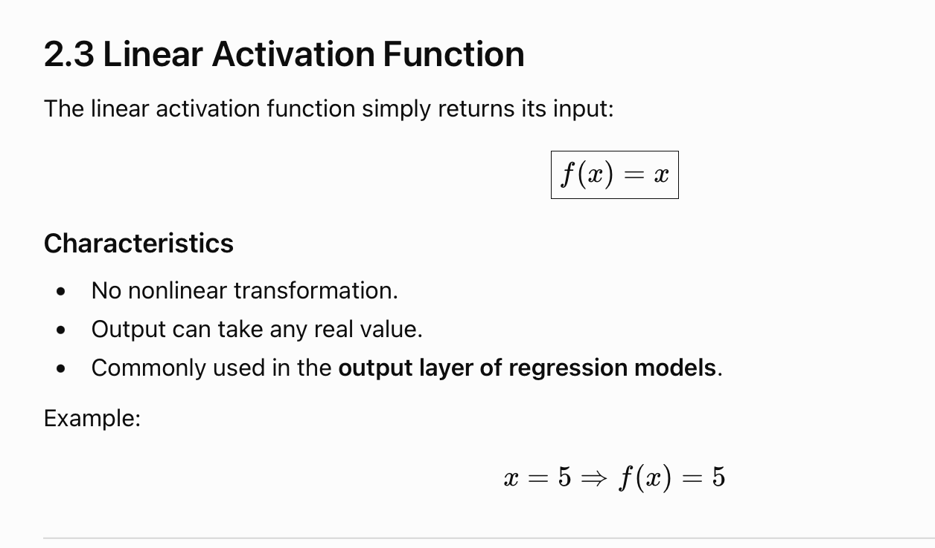
Linear Activation Function

Slide 14
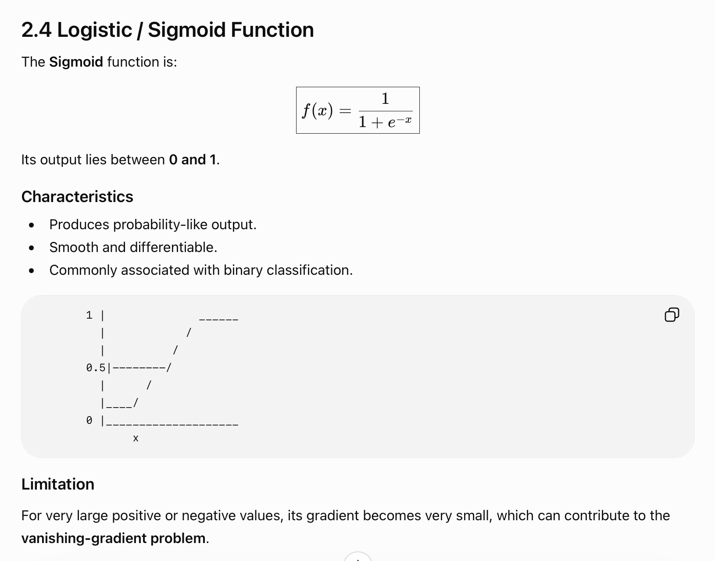

Slide 15
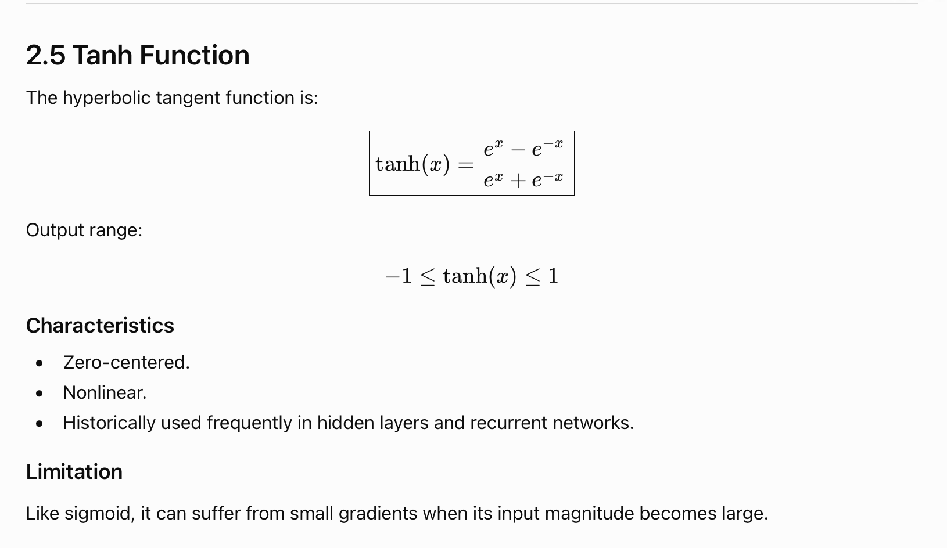
Tanh Function

Slide 16
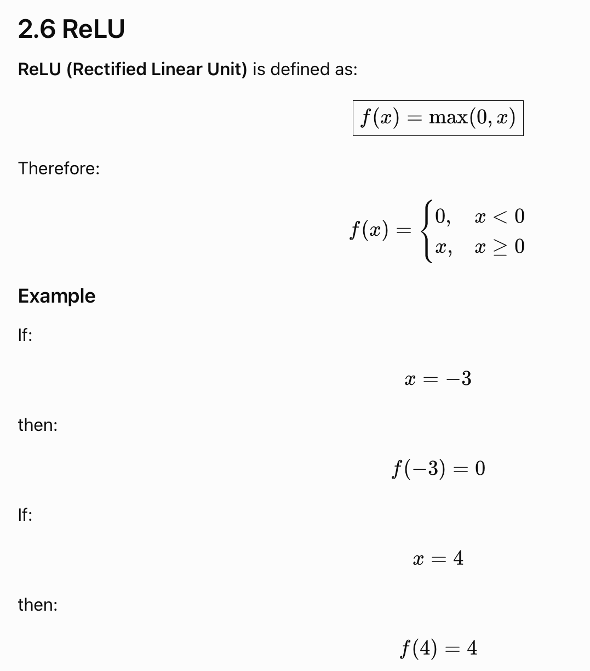
Advantages
Simple and computationally efficient.
Helps reduce some gradient problems compared with sigmoid/tanh in deep networks.
Widely used in hidden layers.
Limitation
For negative inputs, the output is zero, and neurons can sometimes become inactive—known as the dying ReLU problem.

Slide 17
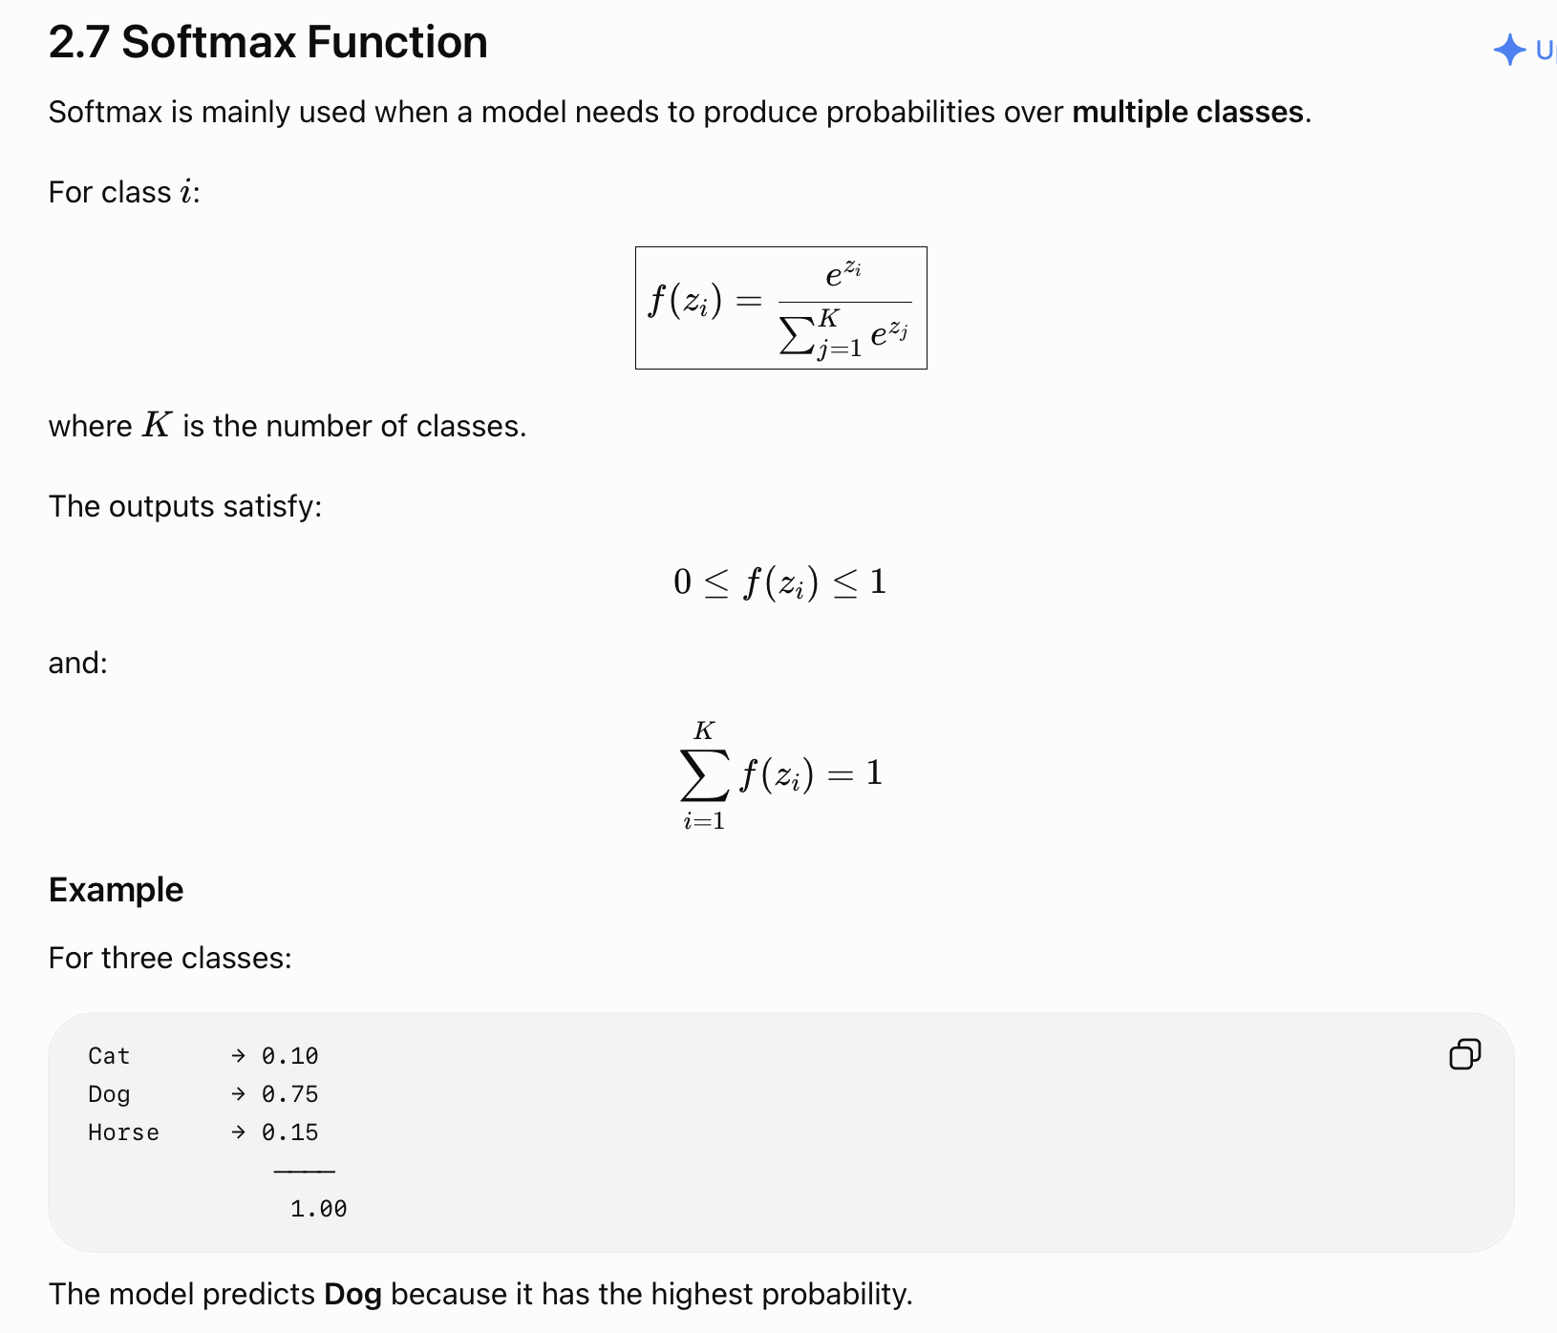
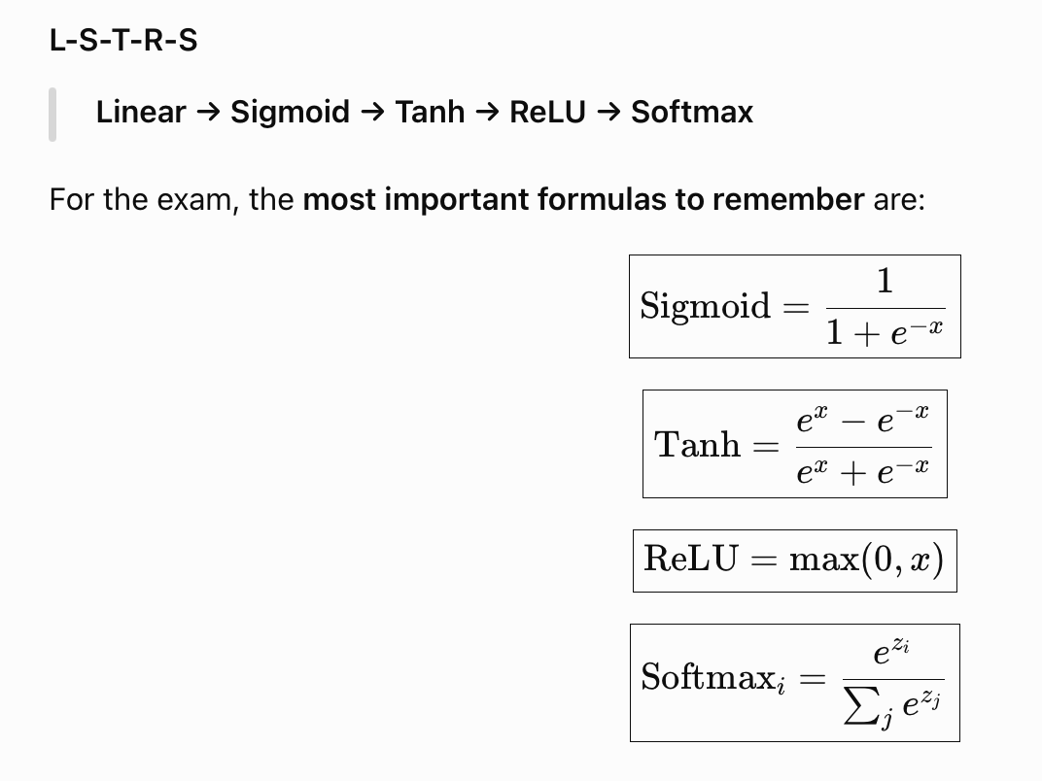

Slide 18
Loss Function
2.3

Slide 19
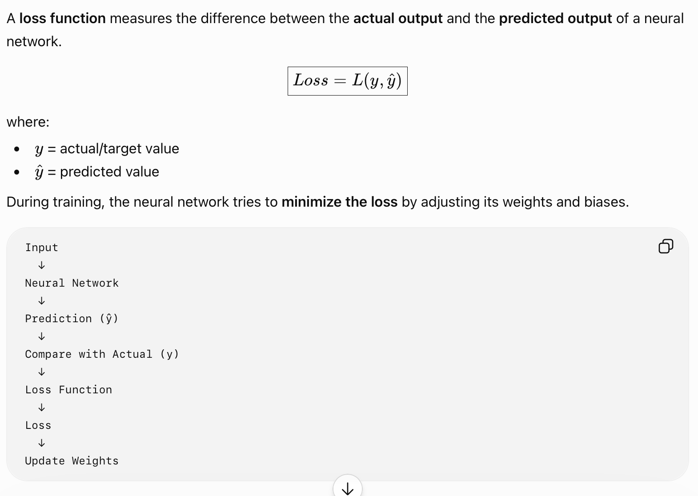
Introduction

Slide 20
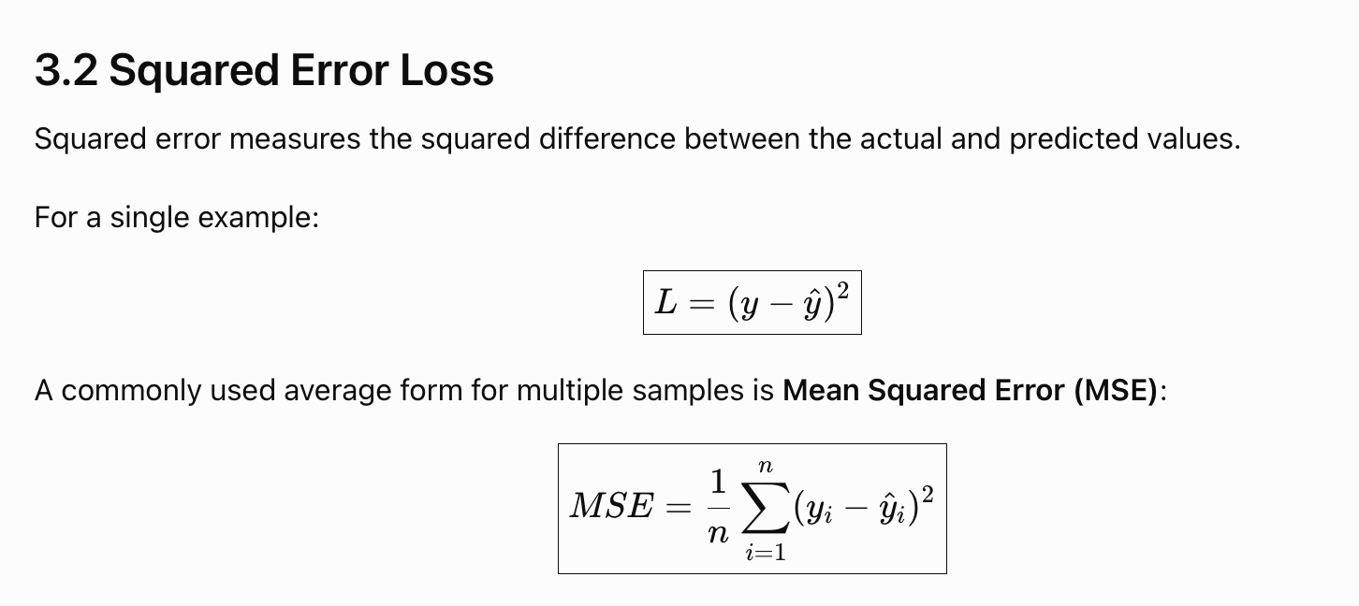

Slide 21
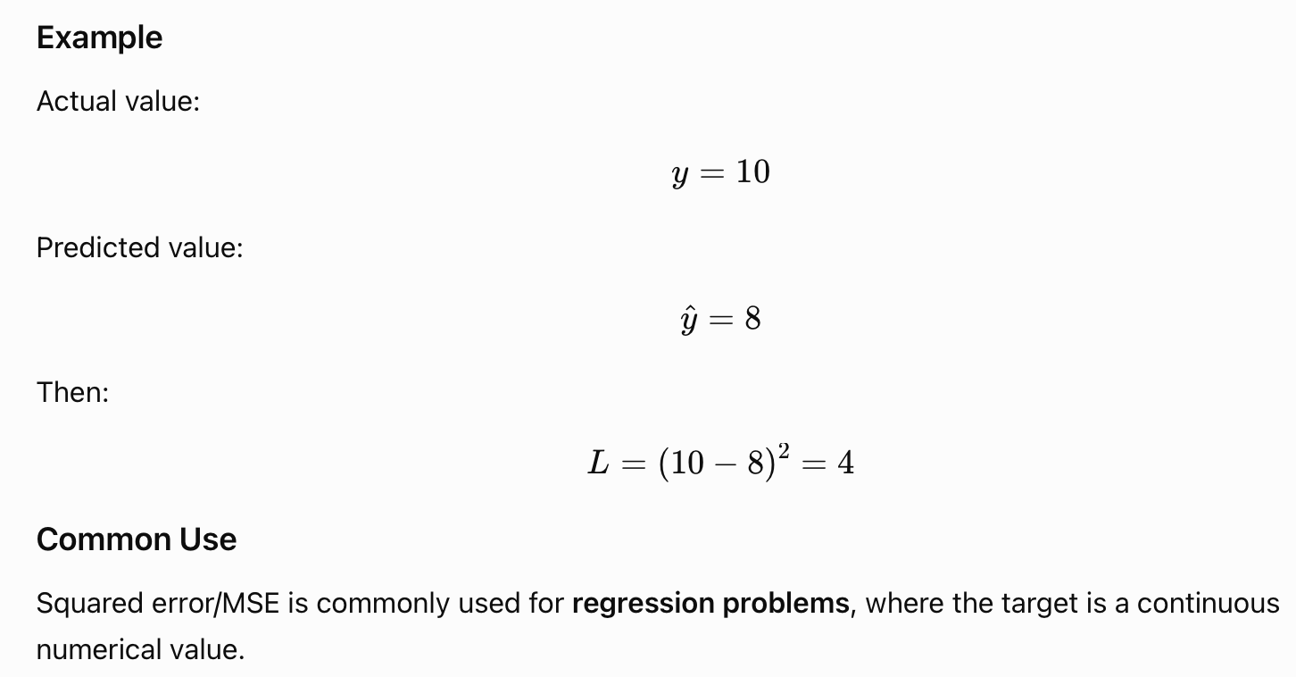

Slide 22
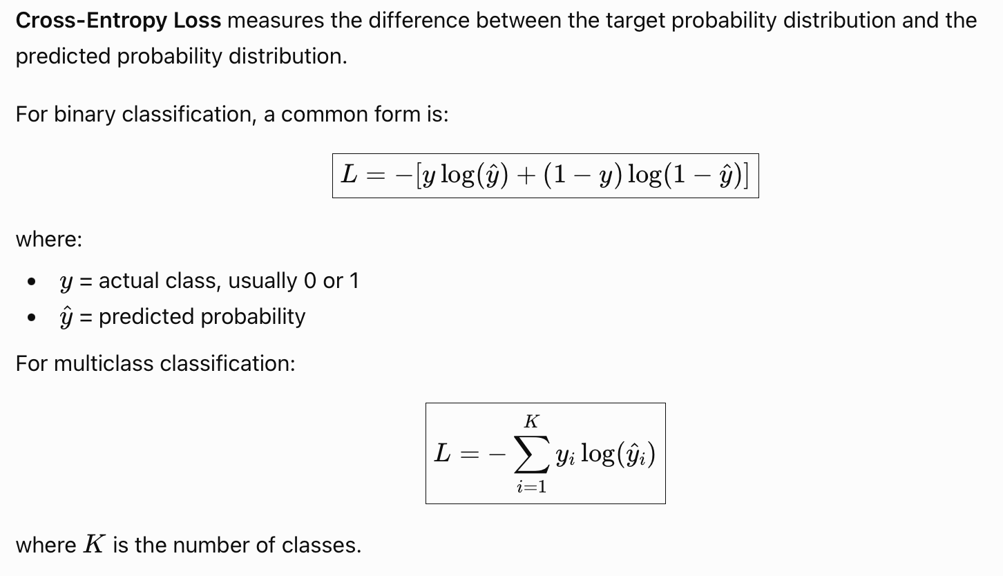
Cross-Entropy Loss

Slide 23
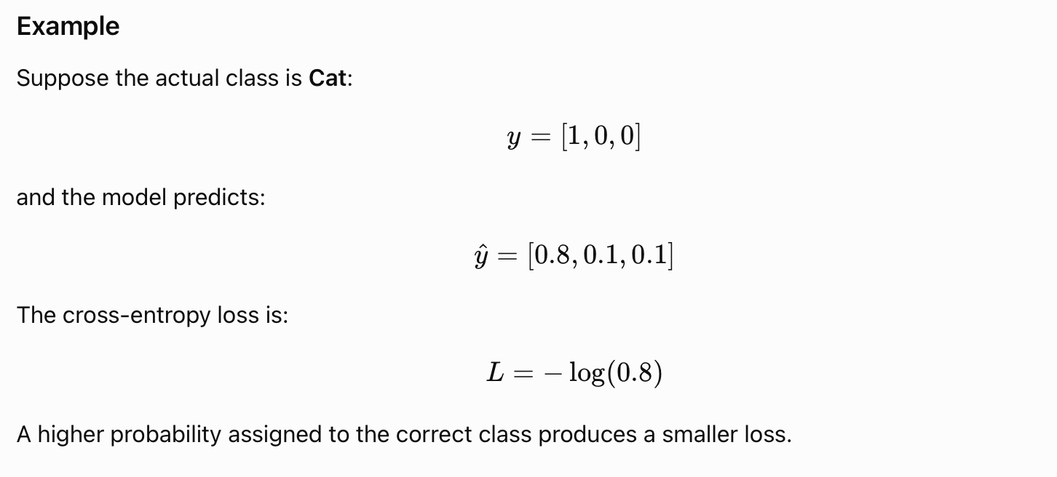
Example

Slide 24
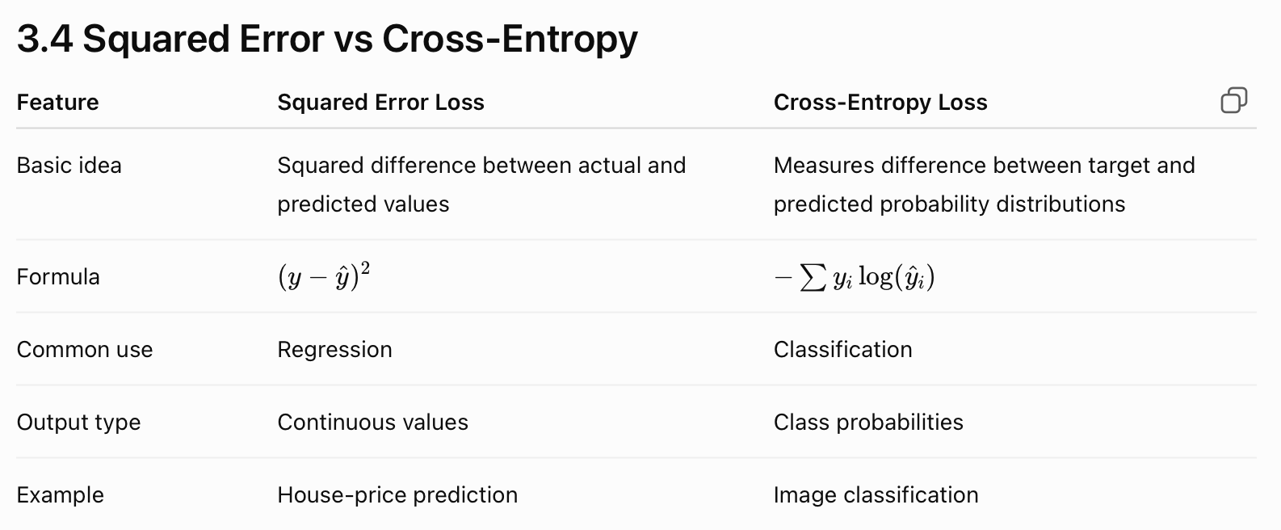

Slide 25
Learning with Backpropagation
2.4

Slide 26
Introduction
Backpropagation is a supervised learning algorithm used to train neural networks. It calculates how much each weight contributes to the error and uses this information to update the network's weights and biases.
It works in two main stages:
Forward Propagation→Backward Propagation

Slide 27
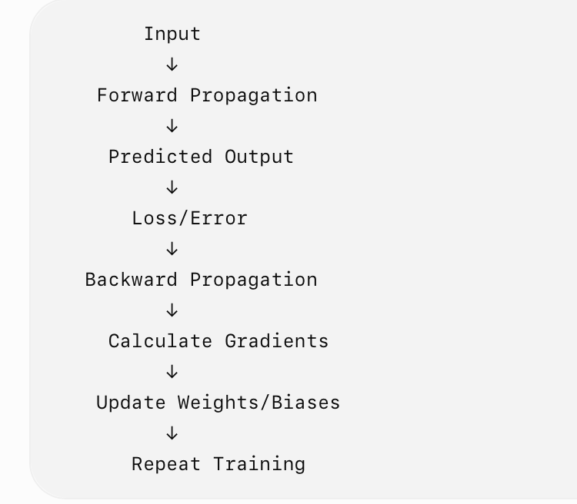
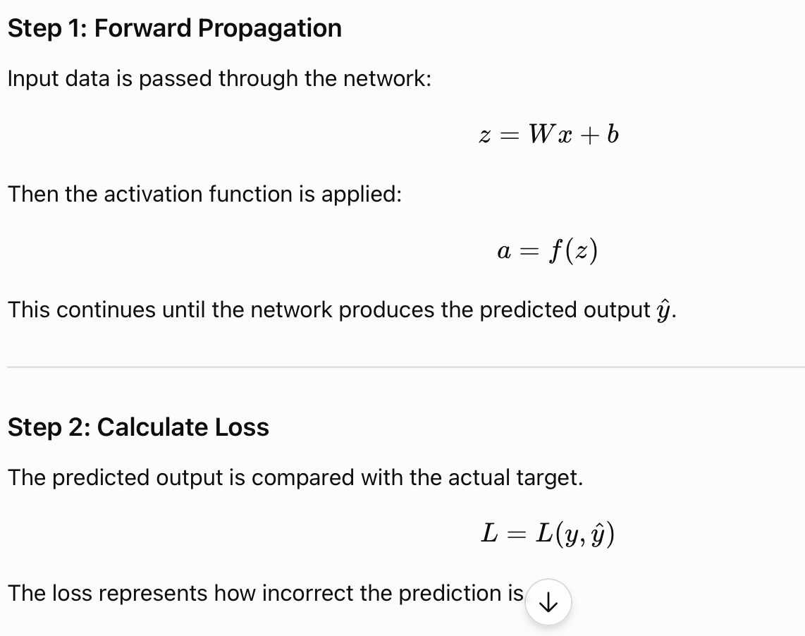
Working of Backpropagation

Slide 28
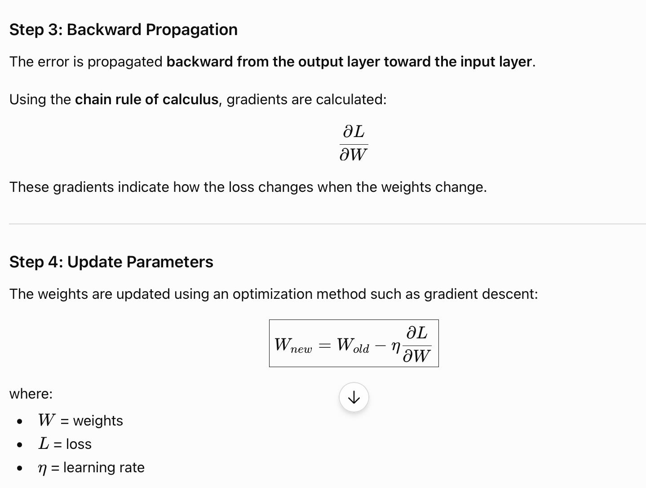

Slide 29
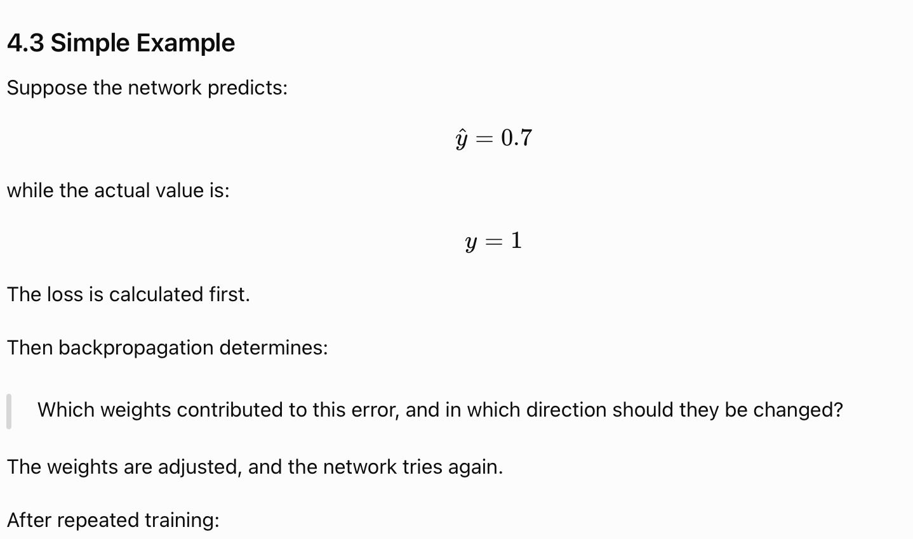
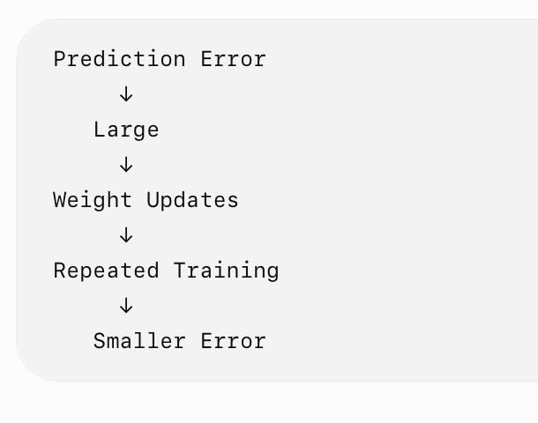

Slide 30
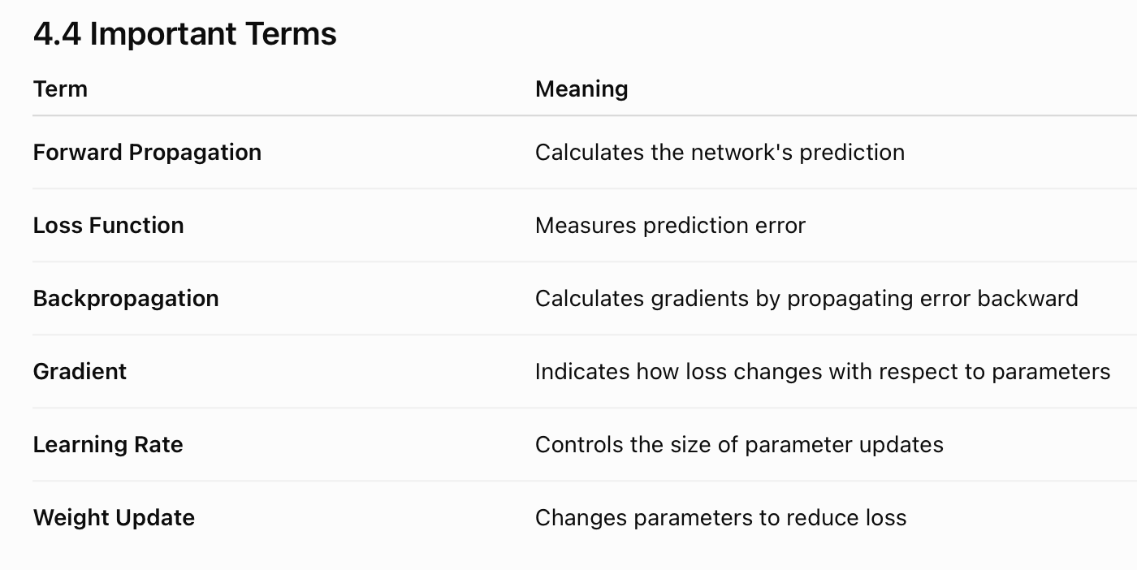

Slide 31
Optimization with Gradient Descent
2.5

Slide 32
Optimization with Gradient Descent - Introduction
Gradient Descent is an optimization algorithm used to minimize the loss function of a neural network. It repeatedly adjusts the model's weights and biases in the direction that reduces the loss.
The basic idea is:
Calculate the gradient → move in the opposite direction → reduce the loss.

Slide 33
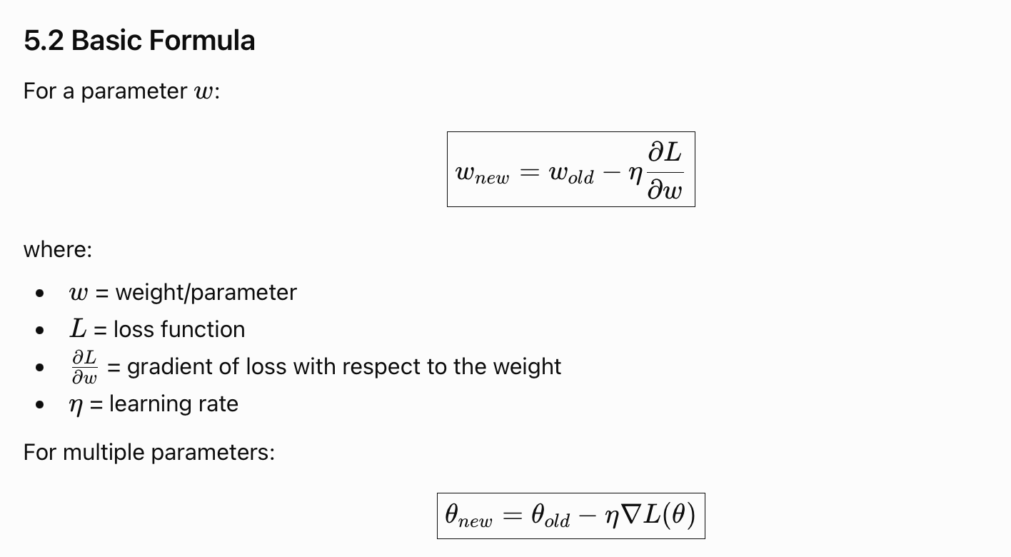
Basic Formula

Slide 34
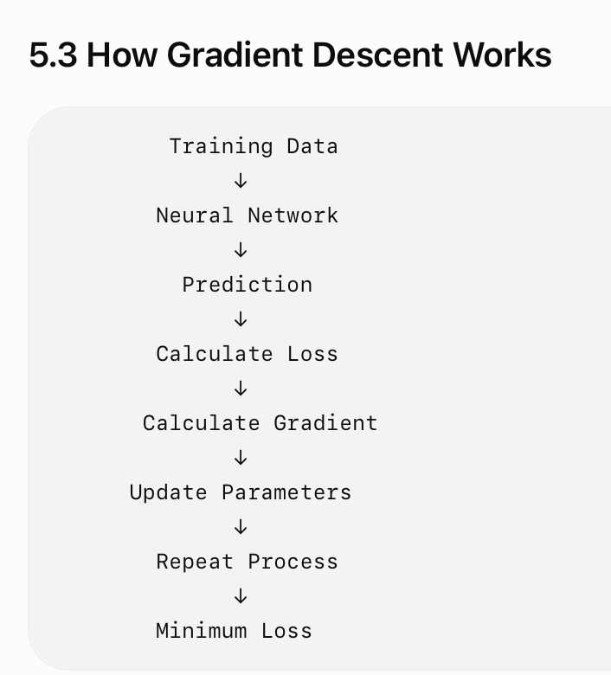
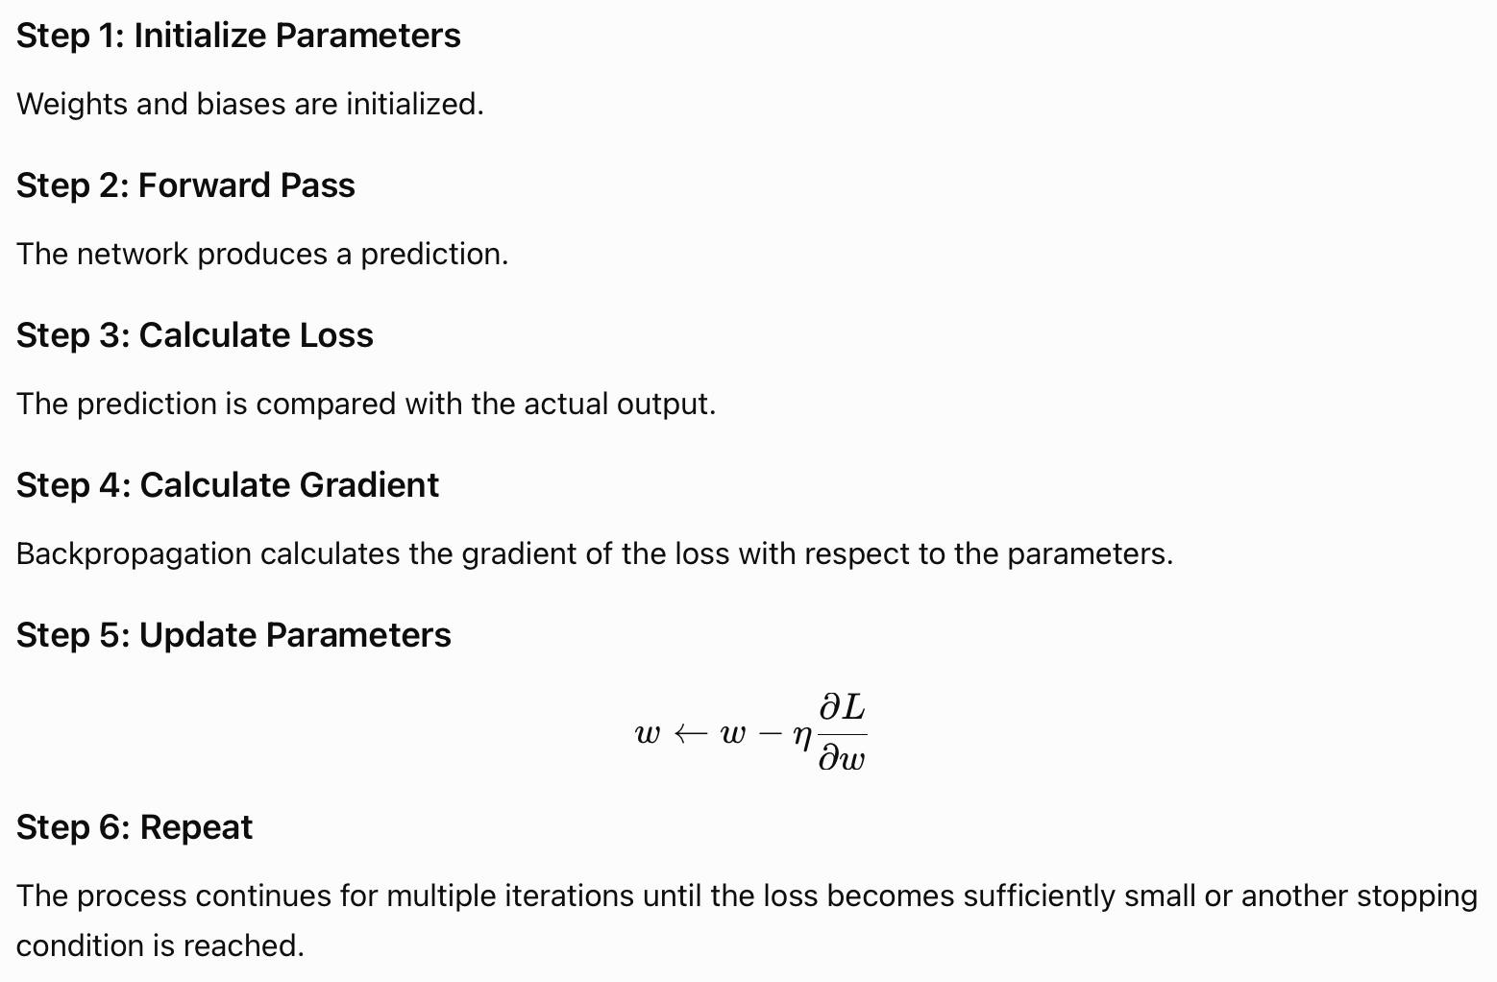
Working

Slide 35
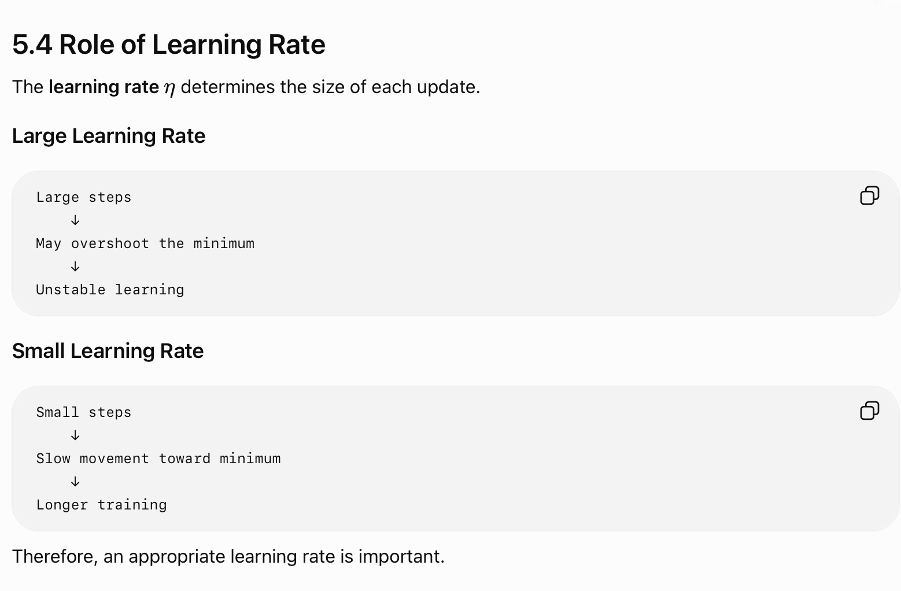

Slide 36
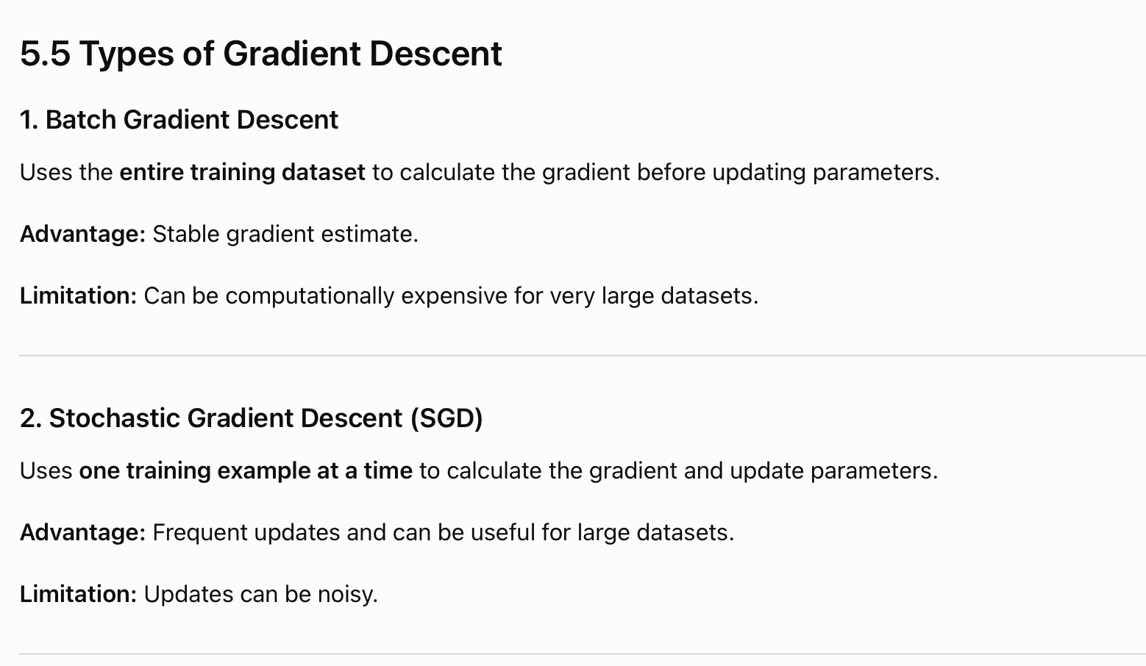
Types of Gradient Decent

Slide 37
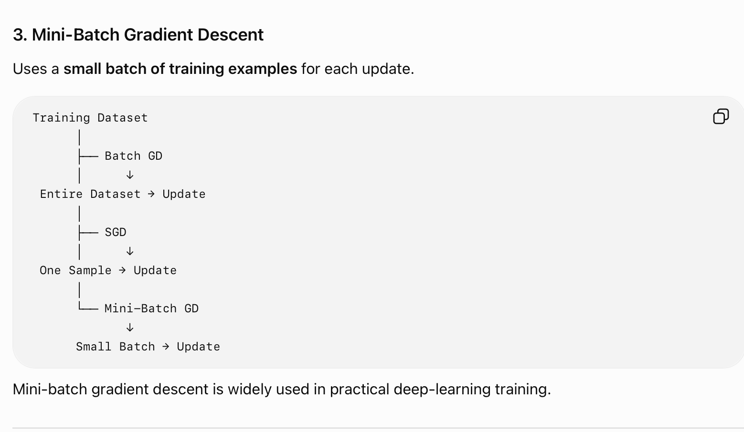

Slide 38
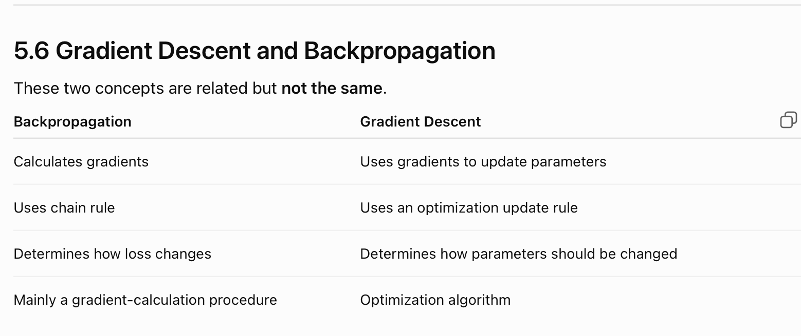

Slide 39
Overfitting
2.6

Slide 40
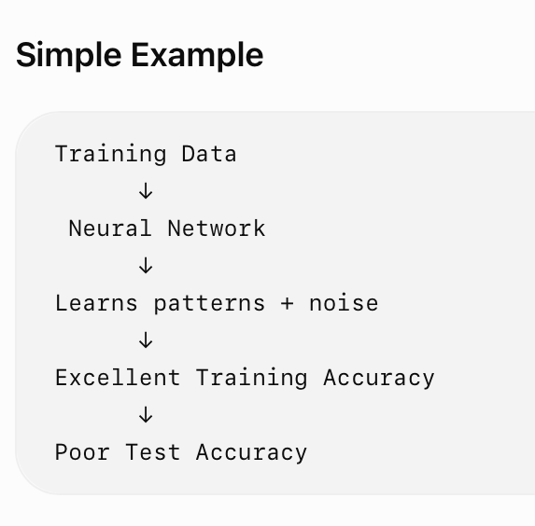
Introduction
Overfitting occurs when a neural network learns the training data too closely, including its noise and specific patterns, instead of learning general patterns that work on unseen data.
As a result:
Training performance is very good
Validation/Test performance is poor

Slide 41
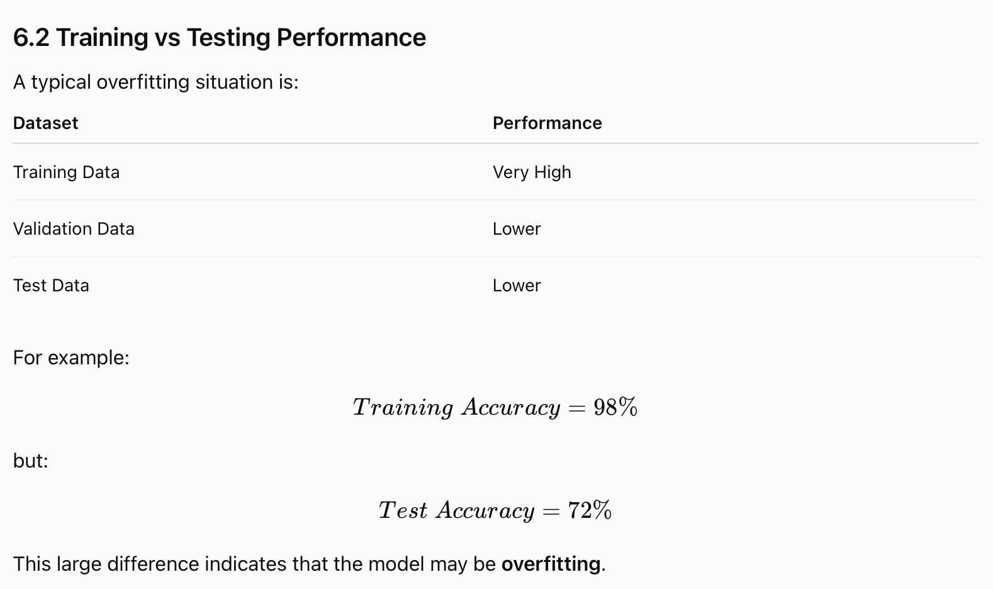

Slide 42
Casues of Overfitting
Common causes include:
Very complex model compared with the amount of training data.
Insufficient training data.
Training for too many epochs.
Noisy or unrepresentative training data.
Excessive number of parameters.

Slide 43
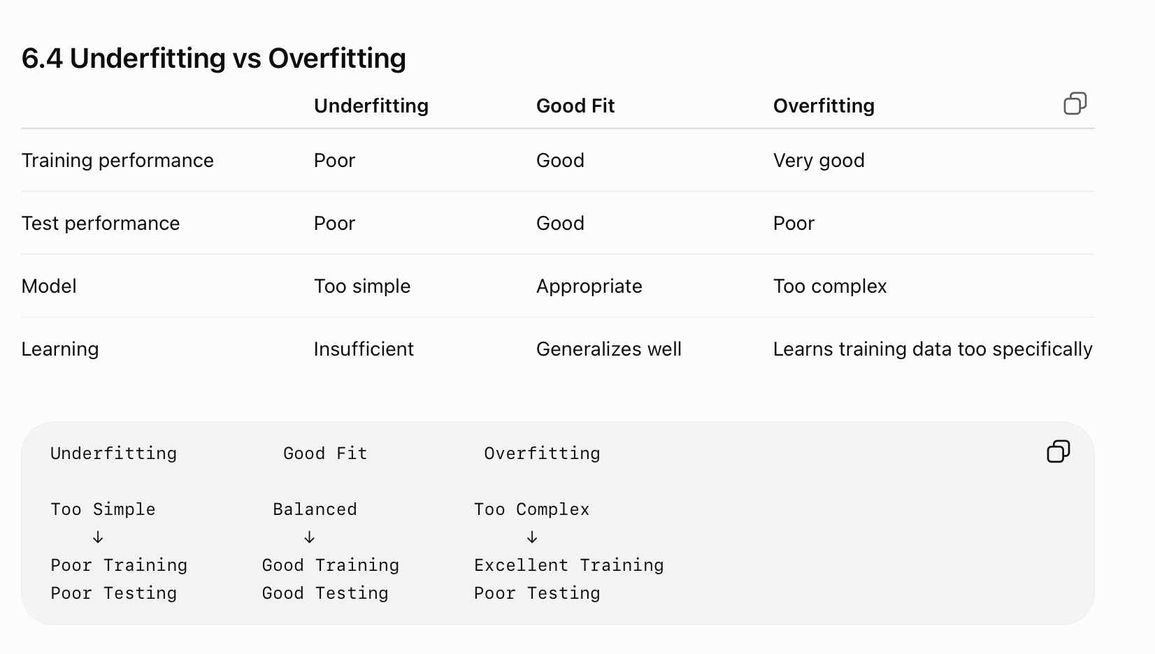

Slide 44
How to Reduce Overfitting
Some common approaches are:
  More training data
  Data augmentation where appropriate
  Regularization
  Dropout
  Early stopping
  Reducing model complexity
Regularization
  Regularization adds a penalty to the learning objective to discourage excessively complex parameter values.
Dropout
  Dropout temporarily removes/ignores a subset of neurons during training, helping reduce reliance on particular neurons.
Early Stopping
  Training is stopped when validation performance stops improving, rather than continuing indefinitely.

Slide 45
Types of Bias
2.7

Slide 46
Bias
Bias is the error introduced when a model makes overly simplified assumptions about the relationship between input and output.
A model with high bias is generally too simple to capture the underlying patterns in the data.
High Bias→Underfitting

Slide 47
Types of Bias
1. High Bias
  A high-bias model makes strong or overly simple assumptions.
  Characteristics:
  Model is too simple.
  Cannot capture important patterns.
  Training error is high.
  Test error is also generally high.
Example: Using a simple linear model for data with a strongly nonlinear relationship.

Slide 48
Types of Bias
2. Low Bias
  A low-bias model makes fewer restrictive assumptions and can represent more complex relationships.
  Characteristics:
  Can capture complex patterns.
  Training error can be low.
If the model is excessively flexible, it may become sensitive to training data, leading to high variance.

Slide 49
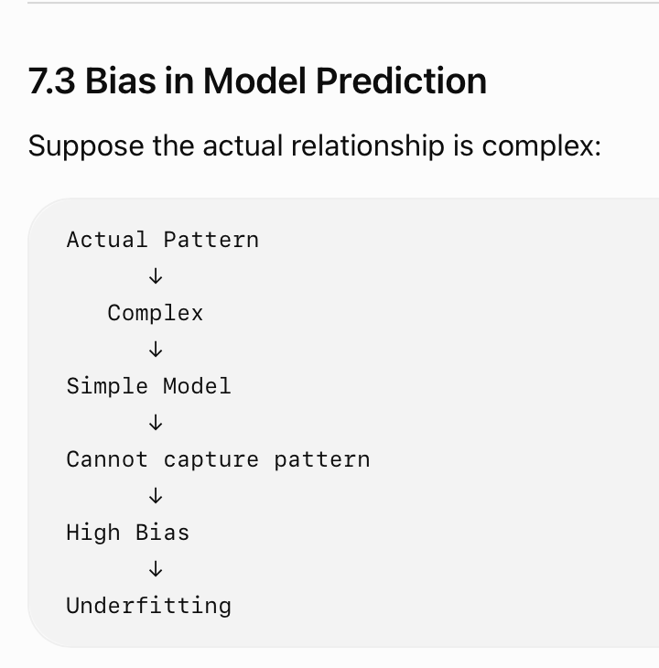

Slide 50
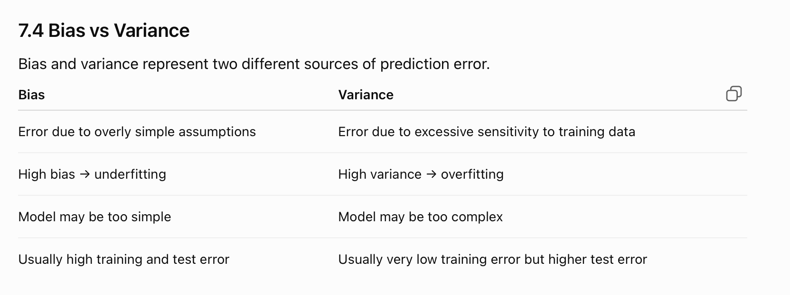

Slide 51
Bias–Variance Tradeoff
2.8

Slide 52
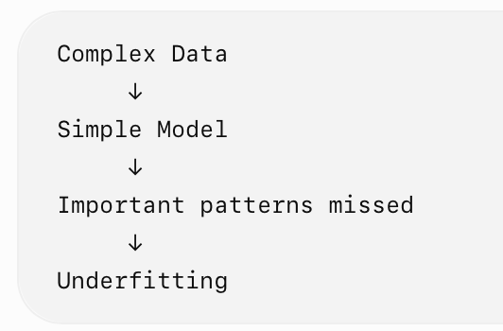
Introduction
The Bias–Variance Tradeoff describes the balance between two sources of prediction error:
Bias → error from an overly simple model.
Variance → error from a model that is too sensitive to the training data.
The goal is to build a model that has low enough bias and low enough variance so that it generalizes well to unseen data.
High Bias means the model is too simple and cannot capture the underlying patterns.
High Bias→Underfitting

Slide 53
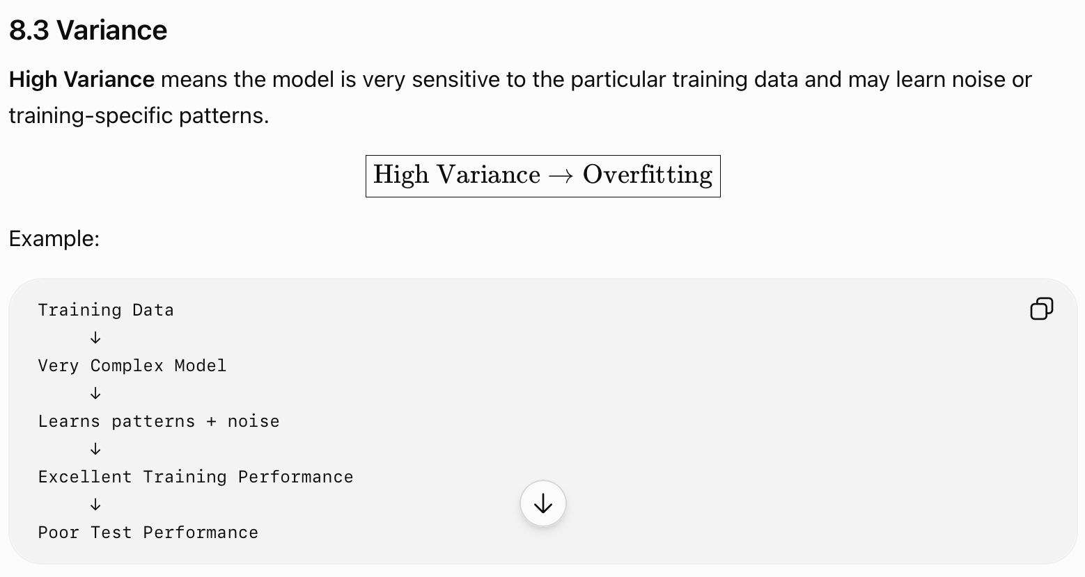

Slide 54
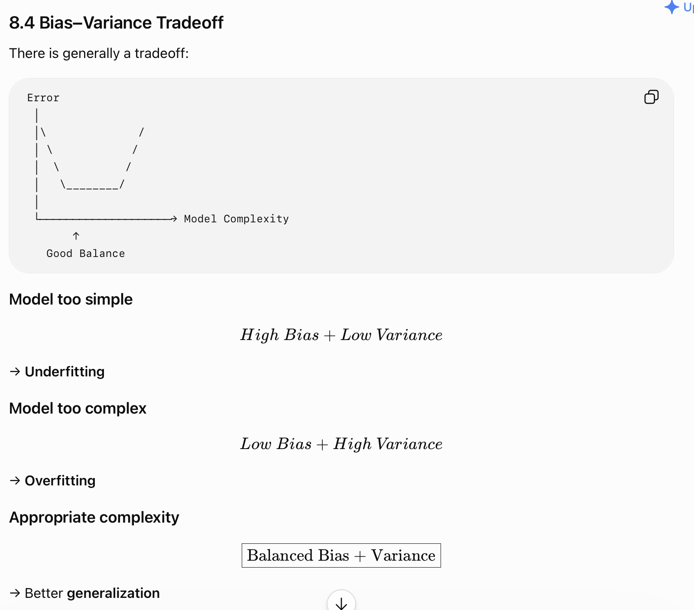

Slide 55
Thank you
Vraj Suratwala
Department of ICT, VNSGU

